Slide 1

Defining Networks with the OSI Model
Lesson 2

Slide 2
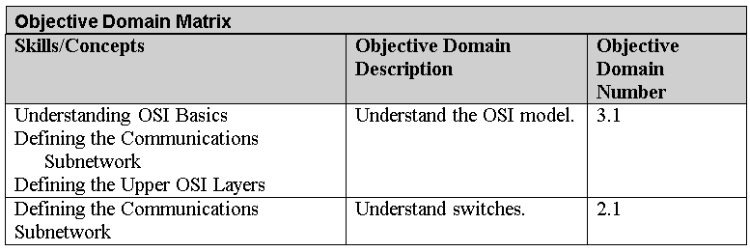
Objectives
Notes:
This should also be a review for the 70-642.

Slide 3
Open Systems Interconnection (OSI)
The Open Systems Interconnection (OSI) reference model is used to define how data communication occurs on computer networks.
This model is divided into layers, each of which provides services to the layers above and below.
These layers are associated with protocols and devices.

Slide 4
OSI Model Layers
Layer 1 – Physical layer
Layer 2 – Data link layer (DLL)
Layer 3 – Network layer
Layer 4 – Transport layer
Layer 5 – Session layer
Layer 6 – Presentation layer
Layer 7 – Application layer
Notes:
All People Seem To Need Data Processing. That mnemonic progresses from layer 7 to layer 1. For a mnemonic that goes in the opposite direction, try Please Do Not Throw Sausage Pizza Away. Or, just memorize the real layer names! It’s up to you.

Slide 5
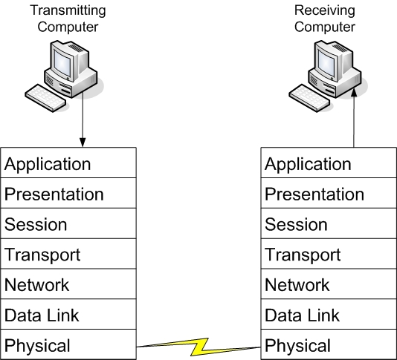
OSI Model Layers

Slide 6
Layer 1 – Physical Layer
This is the physical and electrical medium for data transfer.
It includes but is not limited to cables, jacks, patch panels, punch blocks, hubs, and MAUs.
Concepts related to the physical layer include topologies, analog versus digital/encoding, bit synchronization, baseband versus broadband, multiplexing, and serial (5-volt logic) data transfer.
The unit of measurement used on this layer is bits.

Slide 7
Communications Subnetwork
The communications subnetwork is the guts of OSI model transmissions, consisting of layers 1 through 3.
Regardless of what type of data transmission occurs in a computer network, the communication subnetwork will be employed.

Slide 8
Networking Standards
Networking standards such as 100BASE-T are based on the physical layer.
  The 100 in 100BASE-T stands for 100 Mbps,
  The BASE means baseband
  The T stands for twisted-pair cabling.
Baseband refers to the fact that all computers on the LAN share the same channel or frequency to transmit data, in this case 100 MHz.
Conversely, broadband means that there are multiple channels that can be utilized by the communications system.

Slide 9
Layer 2 – Data Link Layer (DLL)
This layer establishes, maintains, and decides how transfer is accomplished over the physical layer.
Devices that exist on the DLL are network interface cards and bridges.
This layer also ensures error-free transmission over the physical layer under LAN transmissions.
It does so through physical addresses (the hexadecimal address that is burned into the ROM of the NIC), otherwise known as the MAC address (to be discussed more later in this lesson).
The unit of measurement used on this layer is frames.

Slide 10
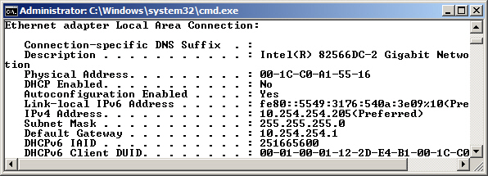
Media Access Control Address
In an Ethernet network, every network adapter must have a unique Media Access Control (MAC) address.
The MAC address is a unique identifier assigned to network adapters by the manufacturer.
This address is six octets in length and is written in hexadecimal

Slide 11
Layer 2 Switches
A layer 2 switch is the most common type of switch used on a LAN.
These switches are hardware based and use the MAC address of each host computer’s network adapter when deciding where to direct frames of data
Every port on the switch is mapped to the specific MAC address of the computer that physically connects to it.

Slide 12
Layer 2 Switches
Security is a concern with layer 2 switches.
Switches have memory that is set aside to store the MAC address to port translation table, known as the Content Addressable Memory table or CAM table.
This table can be compromised with a MAC Flood attack.

Slide 13
Virtual LAN (VLAN)
Layer 2 switching can also allow for a virtual LAN (VLAN) to be implemented.
A VLAN is implemented to segment the network, reduce collisions, organize the network, boost performance, and hopefully, increase security.
The most common standard associated with VLANs is IEEE 802.1Q, which modifies Ethernet frames by “tagging” them with the appropriate VLAN information, based on which VLAN the Ethernet frame should be directed to.
VLANs are used to restrict access to network resources, but this can be bypassed through the use of VLAN hopping.

Slide 14
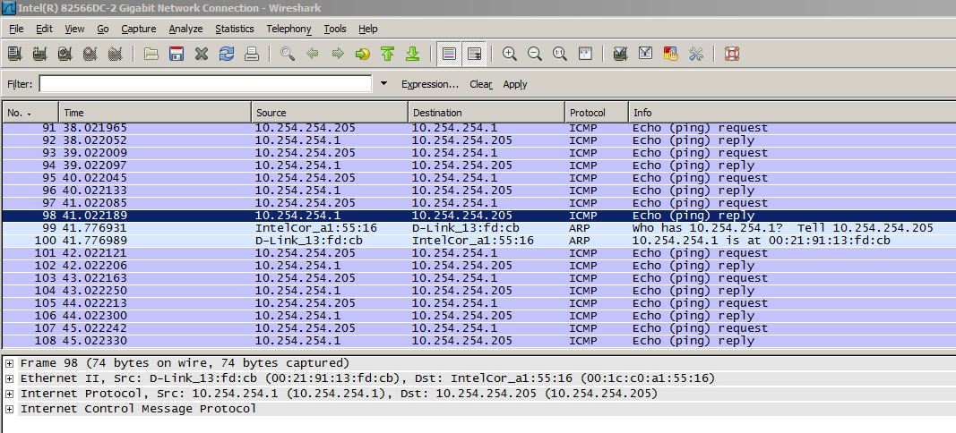
Packets

Slide 15
Layer 3 – Network Layer
This layer is dedicated to routing and switching information to different networks, LANs, or internetworks.
Devices that exist on the network layer are routers and IP switches.
Here, we are getting into the logical addressing of hosts. Instead of physical addresses, the addressing system of the computer is stored in the operating system—for example, IP addresses.
The unit of measurement used on this layer is packets.

Slide 16
Layer 3 Switches
Switches also reside on the network layer.
A layer 3 switch differs from a layer 2 switch in that it determines paths for data using logical addressing (IP addresses) instead of physical addressing (MAC addresses).
Layer 3 switches are similar to routers—it’s how a network engineer implements the switch that makes it different.
Layer 3 switches forward packets, whereas layer 2 switches forward frames.
Layer 3 switches are usually managed switches.

Slide 17
Layer 4 – Transport Layer
This layer ensures error-free transmission between hosts through logical addressing.
  Therefore, it manages the transmission of messages through layers 1 through 3.
The protocols that are categorized by this layer break up messages, send them through the subnet, and ensure correct reassembly at the receiving end, making sure there are no duplicates or lost messages.

Slide 18
TCP and UDP
Two common TCP/IP protocols that are utilized on this layer include the Transmission Control Protocol (TCP), which is a connection-oriented protocol, and the User Datagram Protocol (UDP), which is connectionless.
An example of an application that uses TCP is a web browser, and an example of an application that uses UDP is streaming media.

Slide 19
Layer 4 – Transport Layer
This layer contains both connection-oriented and connectionless systems, which will be covered later in the book.
Inbound and outbound ports are controlled by this layer. When you think “ports,” think the transport layer.
The unit of measurement used on this layer is sometimes referred to as segments or messages. All layers above this one use the terms “data” and “messages.”

Slide 20
Connection Oriented Communications
Connection-oriented (also known as CO mode) communications require that both devices or computers involved in the communication establish an end-to-end logical connection before data can be sent between the two.
These connection-oriented systems are often considered reliable network services.
If an individual packet is not delivered in a timely manner, it is resent; this can be done because the sending computer established the connection at the beginning of the session and knows where to resend the packet.

Slide 21
Connectionless Communications
In connectionless communications (CL mode), no end-to-end connection is necessary before data is sent.
Every packet that is sent has the destination address located in its header.
This is sufficient to move independent packets, such as in the previously mentioned streaming media.
But if a packet is lost, it cannot be resent, because the sending computer never established a logical connection and doesn’t know which logical connection to use to send the failed packet.

Slide 22
Ports
Layer 4 also takes care of the ports that a computer uses for data transmission.
Ports act as logical communications endpoints for computers.
There are a total of 65,536 ports, numbering between 0 and 65,535.
They are defined by the Internet Assigned Numbers Authority or IANA and divided into categories

Slide 23
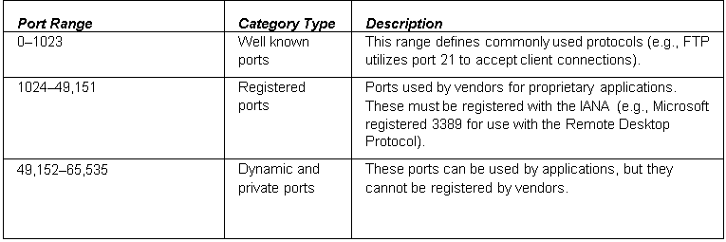
Ports

Slide 24
Ports
It is important to understand the difference between inbound and outbound ports:
  Inbound ports
  Outbound ports

Slide 25
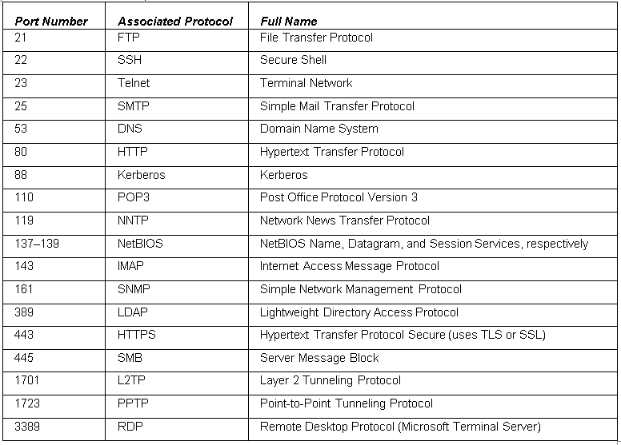
Ports

Slide 26
Layer 5 – Session Layer
This layer governs the establishment, termination, and synchronization of sessions within the OS over the network and between hosts—for example, when you log on and log off.
This is the layer that controls the name and address database for the OS or NOS. NetBIOS (Network Basic Input Output System) works on this layer.

Slide 27
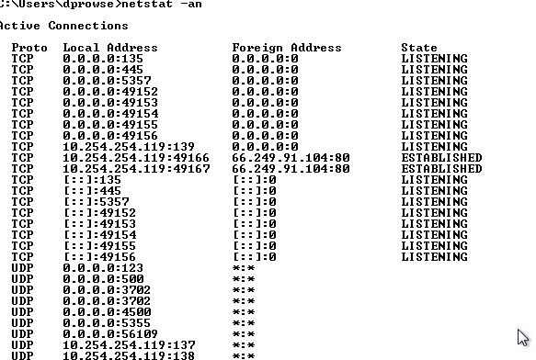
NetStat Command
Notes:
This will display a list of all the connections to and from your computer in numeric format

Slide 28
Layer 6 – Presentation Layer
This layer translates the data format from sender to receiver in the various OSes that may be used.
Concepts include code conversion, data compression, and file encryption.
Redirectors work on this layer, such as mapped network drives that enable a computer to access file shares on a remote computer.

Slide 29
Layer 7 – Application Layer
This layer is where message creation—and, therefore packet creation—begins.
End-user protocols such as FTP, SMTP, Telnet, and RAS work at this layer.
This layer is not the application itself, but the protocols that are initiated by this layer.

Slide 30
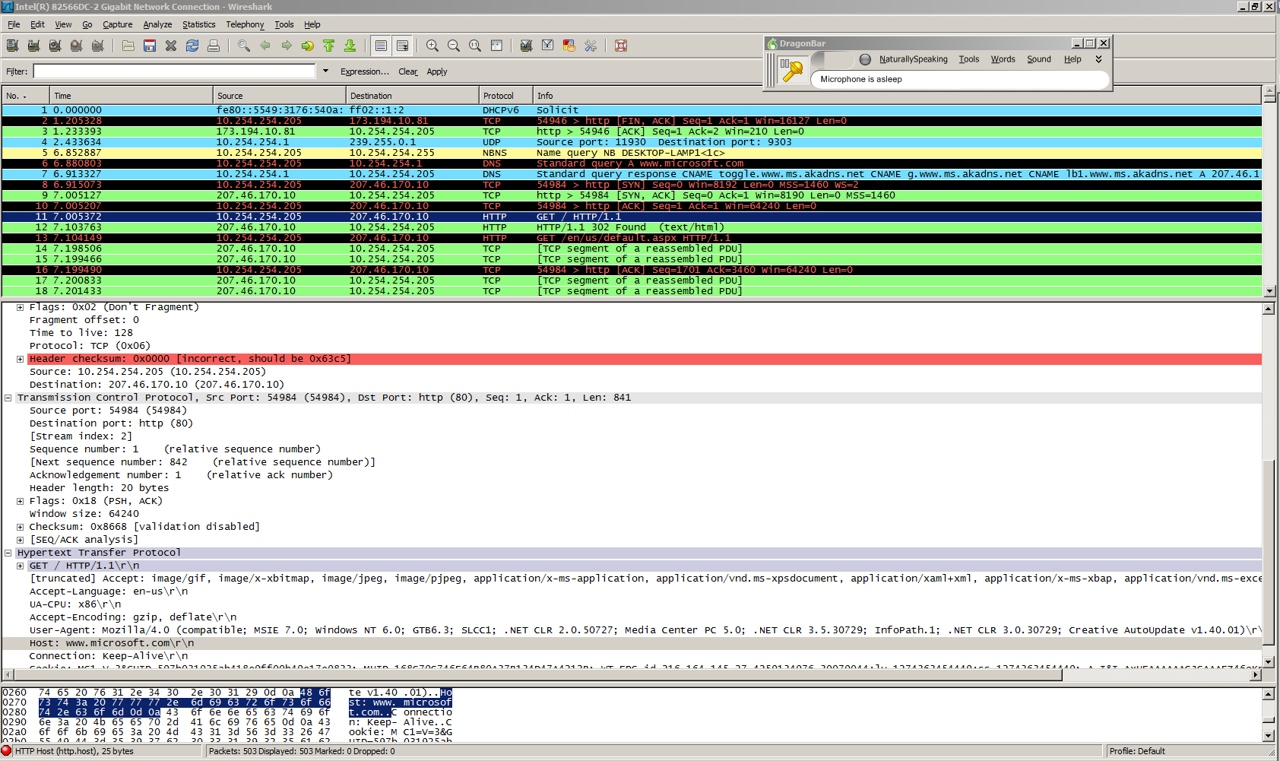
HTTP Packet

Slide 31
OSI Model Revisited

Slide 32
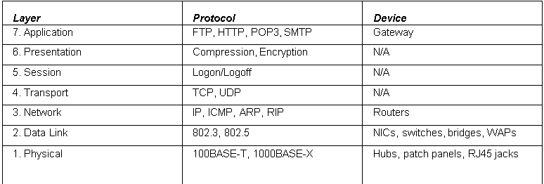
OSI Model Revisited

Slide 33
TCP Model
The TCP/IP (or TCP) model is similar to the OSI model.
It is often used by software manufacturers who are not as concerned with how information is sent over physical media, or how the data link is actually made.
This model is composed of only four layers.

Slide 34
TCP Model
Layer 1: Data link layer (also simply known as the link layer)
Layer 2: Network layer (also known as the Internet layer)
Layer 3: Transport layer
Layer 4: Application layer
The OSI physical layer is skipped altogether, and the application layer comprises the OSI application, presentation, and session layers.

Slide 35
Summary
To understand the OSI model by defining each of the layers from a theory perspective and with hands-on labs.
To be able to separate the functions of the lower levels of the OSI, or the communications subnetwork, from the upper levels where message creation begins.
To understand the differences between layer 2 and layer 3 switches, and to gain a basic understanding of how they operate.
To differentiate between the OSI model and the TCP model.

